Slide 1
CSIT 200 Week 13 building a gui
Python Programming
LinDa Yang
W-307

Slide 2
outline
Explore the GUI and its components

Slide 3
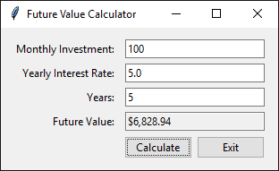
A window with ten components

Slide 4
The constructor of the root window

Slide 5
How to import the tkinter module

Slide 6
Two constructors of the ttk module

Slide 7
How to import the ttk module

Slide 8
How to add two buttons to the frame

Slide 9
An argument of the Button constructor

Slide 10
How to connect two buttons to callback functions

Slide 11
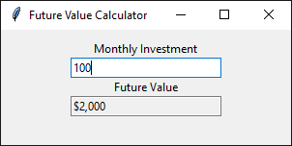
A window with labels and text entry fields

Slide 12
Constructors for labels and text entry fields

Slide 13
How to create a label and display it

Slide 14
Constructors and methods of the StringVar class

Slide 15
How to bind a text entry field to a StringVar object

Slide 16
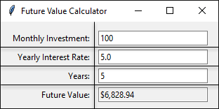
Eight components in a grid

Slide 17
Some arguments of the grid() method
Column where component should be added (index starts at 0)
Row where the component should be added
Which side of the container the component should stick to (N, S, E, W).
Specifies horizontal padding
Specifies vertical padding
Specifies number of columns the component should span
Specifies the number of rows the component should span

Slide 18
How to lay out components in a grid

Slide 19

A window that contains a frame

Slide 20
A class that defines a frame

Slide 21
A class that defines a frame (cont.)

Slide 22
The GUI for the Future Value Calculator

Slide 23
The business module

Slide 24
The ui module

Slide 25
The ui module (continued)

Slide 26
The ui module (continued)

Slide 27
The ui module (continued)

